Slide 1


BASRAH UNIVERSITY
Faculty of Education for Pure Sciences
Biology Department
2025- 2026
Introduction to Invertebrates
& Principles of Classification of Organisms
(2nd Grade)
Presented By: Prof. Dr. Sabeeh H. AL-Mayah

Slide 2
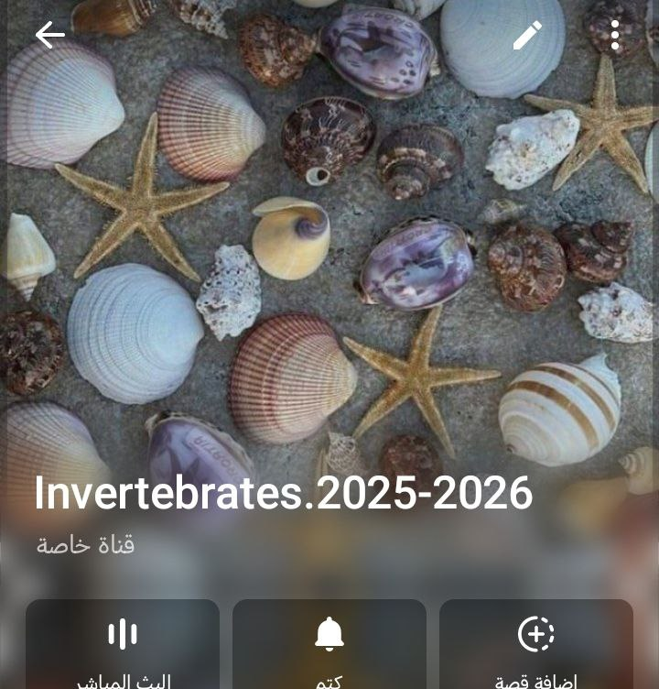
https://t.me/+tEETUaLm_pA2NGQy

Slide 3
Objectives
To introduce the student to the diversity, form, and structures of invertebrates.
Define the main phylum of invertebrates and study the general and taxonomic characteristics of each phylum.
To understand the evolutionary relationships among invertebrate groups.
To recognize the environmental and economic importance of invertebrates.
To have students conduct practical examinations and identify live or preserved specimens.

Slide 4
Introduction to Invertebrates
Most of the species that inhabit the earth are animals
Some possess a backbone or vertebral column, but many do not.
Animals throughout the world are divided into two major groups; those that possess a backbone (vertebrates) and those that do not (invertebrates).

Slide 5
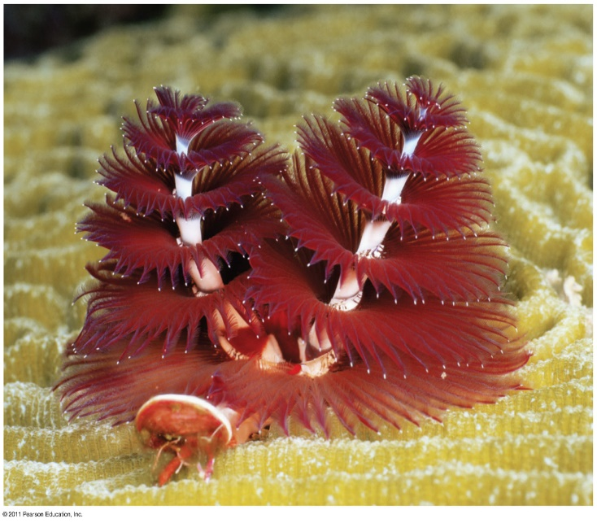
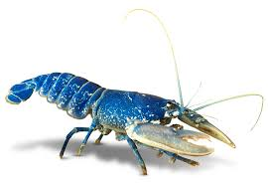
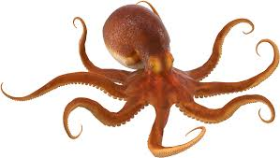
Invertebrates
Invertebrates are the animals that have no backbone (vertebral column, spinal cord), This is by far the largest group in the animal kingdom: 97 percent of all animals are invertebrates, ranging from microscopic protozoa to giant squids. .
Many invertebrates have a fluid-filled skeleton like jellyfish or worm , other invertebrates have hard outer shell, like insects and crustacea.

Slide 6
Importance of Invertebrates
Invertebrates are found in all habitats including the depths of the oceans and on glacial ice.
• Ecological roles:
- Invertebrates serve various important ecological roles including consumption and reduction of organic matter, decomposition, and as a food source.
• Economic importance:
- Silk (silkworm), honey (bees), pearl(oysters), seafood (mollusks, crustaceans).
• Medical importance and pharmaceutical sources.
• Indicators of environmental health.
• Educational and scientific research models.

Slide 7
Classification
Classification is a man-made system deals with the identification, description and nomenclature of different species to put them in their special classification orders.
A. Arrangement in classes or groups to improve communication between scientists.
Four factors used to classify
1. They have similar structures
2. They have similar behaviors
33. They eat the same kinds of things
4. They have the same chemical make up.

Slide 8
Classification of Living things
The earth is inhabited by millions of different kinds of organisms. To study them, we need to group (classify) them and give them names
Classification of organisms refers to the process of putting together organisms that bear resemblance to one another
Taxonomy refers to the science of classifying organisms into natural groupings
Biosystematics is the science through which life forms are discovered, identified, described, named, classified and catalogued, with their diversity, life histories, living habits, roles in an ecosystem, and spatial and geographical distributions recorded. It can also be defined as the study of the kinds and diversity of organisms and the relationship between them
Organisms were first classified more than 2000yrs ago by Aristotle (Greek) into plants or animals. Later, this simple classification was expanded by the Romans who grouped animals into units/groups called genera (sing: genus)
E.g. the cats were assigned the genus Felis, horses to genus Equus etc.

Slide 9
Linnaeus Classification
Linnaeus reorganized 7 categories of classification: species, genus, family, order, class, phylum and kingdom in a hierarchical order.
Each category in the hierarchy is a collective unit containing one or more groups from the next lower level.
A genus is a group of closely related species; a family is a group of related genera; an order is a group of closely related families etc
From evolutionary point of view, species in any one genus are believed to be more closely related than to species in any other genus.

Slide 10
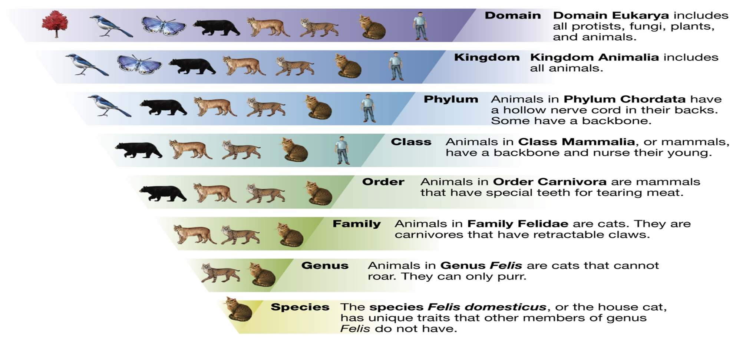

What are the levels of classification?

Slide 11
Binomial nomenclature
Until 250 years ago, biologists used to add a series of descriptive terms to the name of the genus when they wanted to refer to a particular kind of organisms (species). There were so many phrases used, and the system was known as Polynomial system
Swedish biologist; Carolus Linnaeus(1707-78) simplified the system into a Binomial nomenclature system in which a species is given a name consisting of two words; first word, refers to the name of the genus in which that species belongs and the second word, refers to a designation for that species. The combination of the two words constituted scientific name for the species
E.g. Honeybee is scientifically named Apis melifera.

Slide 12
Binomial nomenclature contd:
Normally, scientific names are italicized or underlined, with the generic name capitalized and the specific name all in small case letters.
Upon first mention of a species in any write up, full name must be given, but the name can be abbreviated to the first letter of the genus and the species name in subsequent mention.
However, in some cases, particularly in the mosquito literature, the genus name abbreviation consists of two letters, Ae. for Aedes, An. for Anopheles, Cx. for Culex, Cs. for Culiseta, and so on.
Sp. and Spp. : When dealing with organisms for which, for various reasons, we know the genus, but not the species, the organism is identified by the generic name followed by the abbreviation "sp“. The plural abbreviation "spp." is usually used to refer to all the individual species within a genus. i.e. sp.= single species spp.= plural, several species. These abbreviations can also be used when the names of the specific species is not important to the subject under discussion.

Slide 13
Biological Species Concept
The term species was first proposed by John Ray, an English clergyman and scientist, around 1700. He pointed out that all individuals that belong to a given species breed with one another and produce fertile progeny. This concept is still used today
breeds of dogs are one species, as they can all interbreed, even if some individuals look so different
Ernst Mayr, an American, the father of population genetics and an evolutionist, has redefined the concept, pointing out that “species are groups of actually or potentially interbreeding natural populations which are reproductively isolated from one another”
The biological species concept works fairly well for animals where there are strong barriers to hybridization between species

Slide 14
Biological Species Concept
Animals regularly outcross, and so the concept works well. Outcrossing is less common in other kingdoms
Species in the other kingdoms-bacteria, fungi, etc do not outcross/interbreed with one another as many reproduce asexually and so cannot be characterized in the same way as outcrossing animals and plants
Most species can be separated by fairly obvious anatomical, physiological and behavioral characters but the final and key separation criterion is reproduction, i.e. whether or not there is actual or potential gene flow

Slide 15
Kingdoms of the Life
In his classification schem , Linnaeus(1735) Recognized only two kingdoms of living things : Animalia and Plantae . At the time, microscopic organisms had not been studied in detail. They were placed either in a separate category called Chaos or, in some cases; they were classified with plants or animals .

Slide 16
5 Kingdoms
Until recently the system devised by Robert Whittaker in 1968 was widely adopted.
Whittaker’s classification schem recognizes five kingdoms: Monera , Protista , Fungi , Plantae , and Animalia .
It is based mainly on differences in nutrition ; his Plantae were mostly multicellular autotrophs, his Animalia multicellular heterotrophs , and his Fungi Multicellular saprotrophs. The remaining two kingdoms ,
Protista and Monera , included unicellular(colony ).

Slide 17
6 Kingdom
Based on RNA studies Carl Woese divided the prokaryotes
(kingdom Monera) into two kingdoms ,called Eubacteria and
Archaebacteria .Carl Woese Attempted to establish a three
primary kingdom (or Urkingdom)system in which plants,
Animals, protist and Fungi were lumped All eukaryotes.
the Eubacteria and Archaebacteria Made up the other two urkingdom .

Slide 18
Invertebrates Phyla
So, Invertebrates include the following phyla:
Phylum: Protozoa
Phylum: Porifera
Phylum: Coelentrata
Phylum: Platyhelminthes
Phylum: Nematoda
Phylum: Acanthocephala
Phylum: Annelida
Phylum: Arthropoda
Phylum: Mollusca
Phylum: Echinodermata
While Vertebrates possess back bone include the following phylum only:
Phylum: Chordata

Slide 19
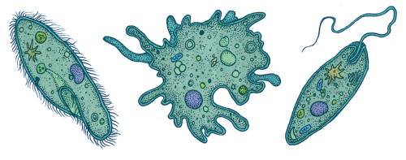
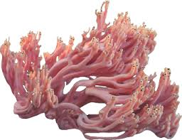
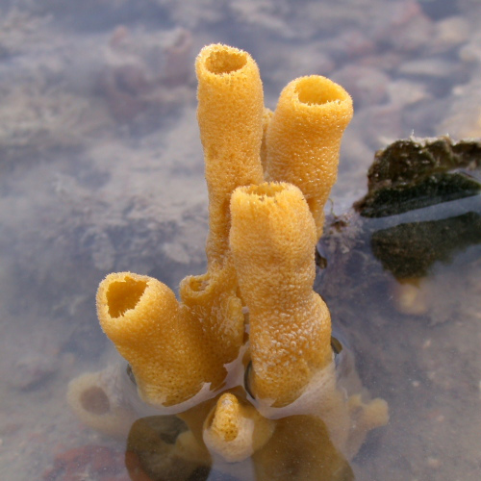
Phylum: Protozoa
Amoeba
Trypanosoma
Paramecium
Phylum: Porifera

Slide 20
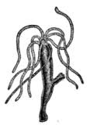
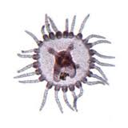
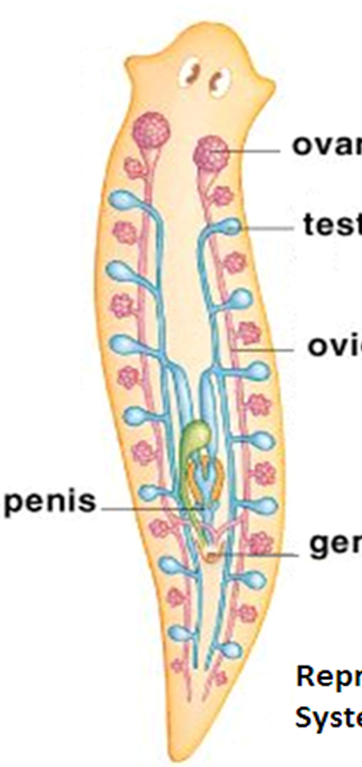
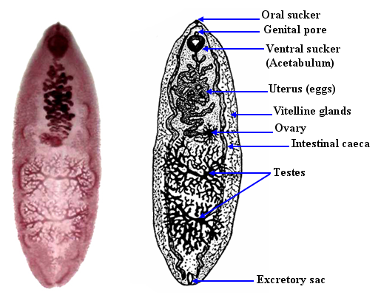

Phylum: Coelentrata

Slide 21
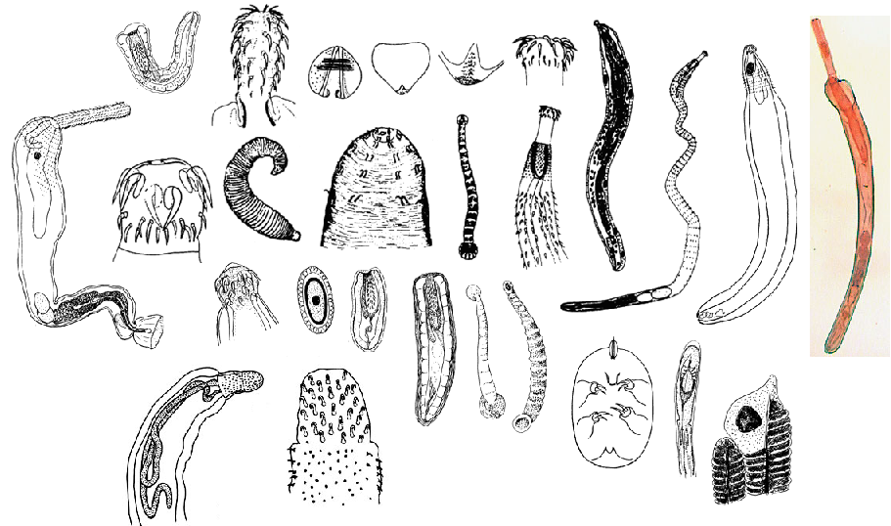
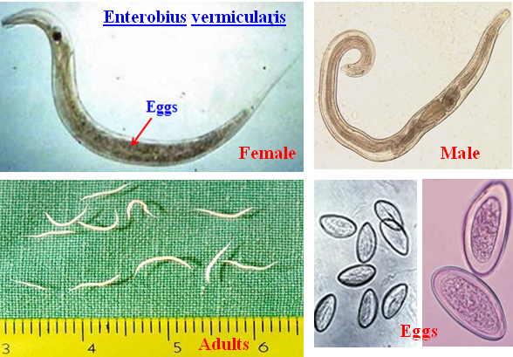
Phylum: Acanthocephala
Phylum: Nematoda

Slide 22
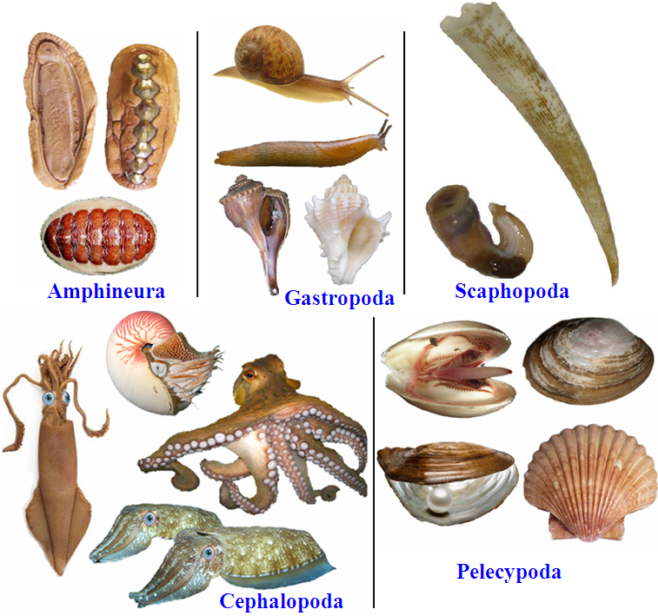
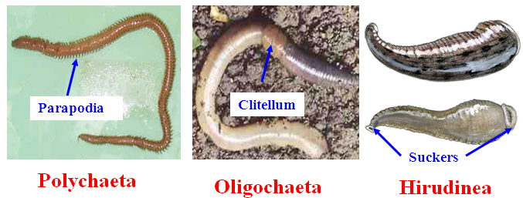
Phylum: Mollusca
Phylum: Annelida

Slide 23
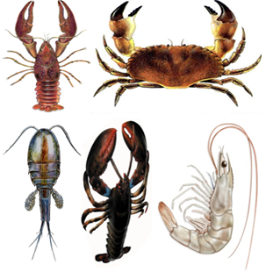
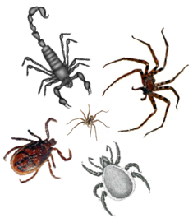
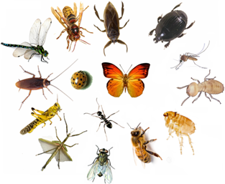
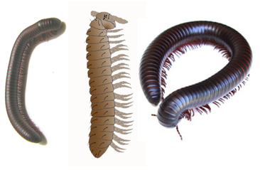
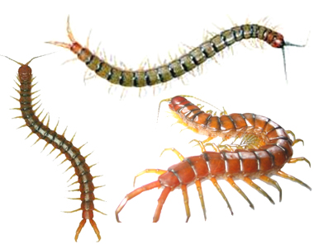
Phylum: Arthropoda
1. Crustacea
2. Arachnida
3. Insecta
4. Diplopoda
5. Chilipoda

Slide 24
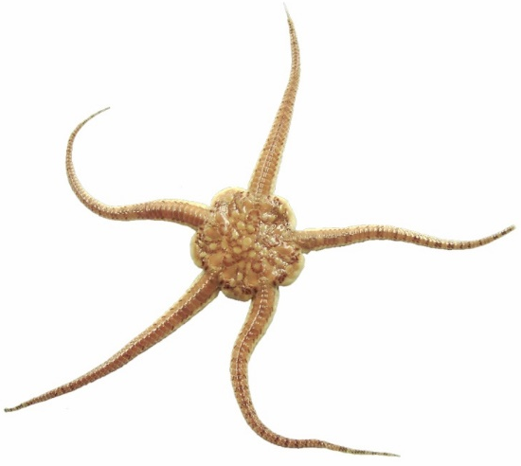
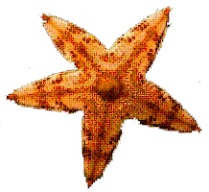
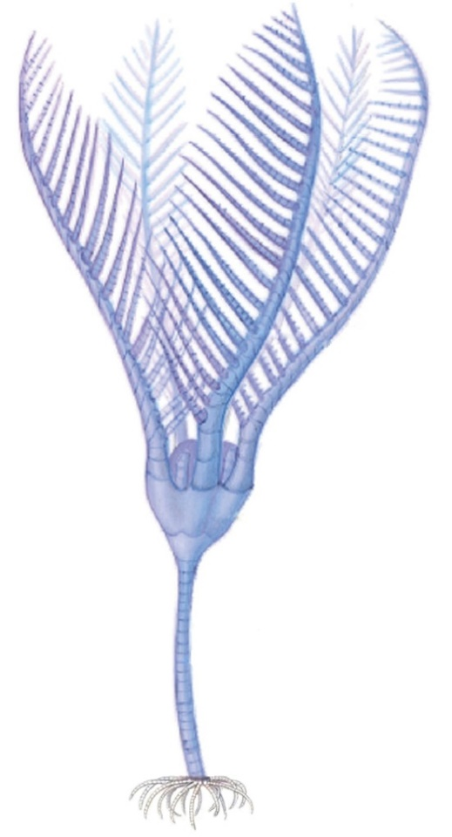
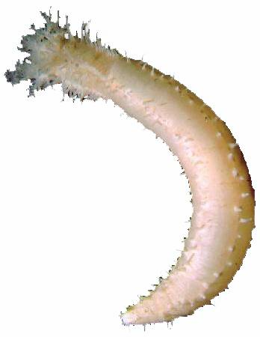
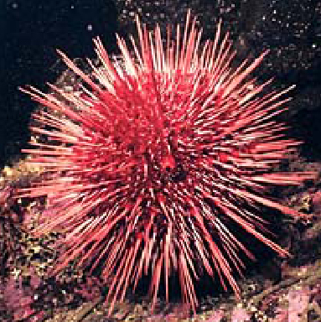
Phylum: Echinodermata
1. Asteroidea e.g. sea star
2. Ophiuroidea e.g. sea serpent
5. Crinoidea
e.g. sea lily
3. Echinoidea e.g. sea urchin
4. Holothuroidea e.g. sea cucumber

Slide 25
Thank You!

